Slide 1
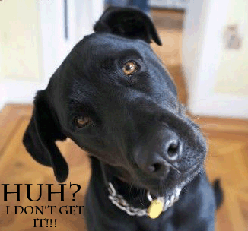
Please take out your blue
characterization packets
Complete the warmup:
What confuses or frustrates you about characterization?

Slide 2
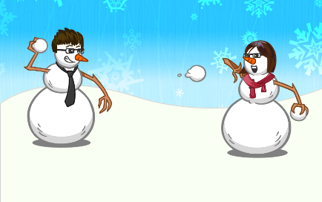
Snowball Fight Rules:
Crumble up your opener
When I start the timer, the class has 1 minute to have a friendly snowball fight with the crumbled opener papers.
When the timer is done, everyone takes one snowball and un-crinkles it.
Share out responses!!

Slide 3
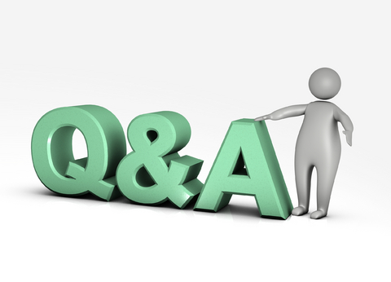
Q and A for Tic Tac Tale Projects????

